Slide 1
Texture
CSU0021: Computer Graphics

Slide 2
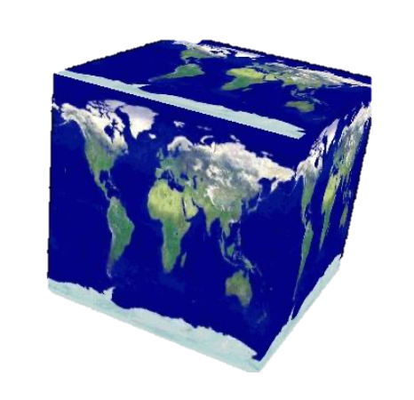
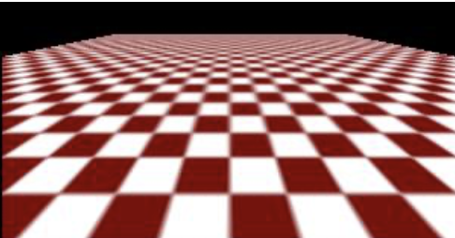
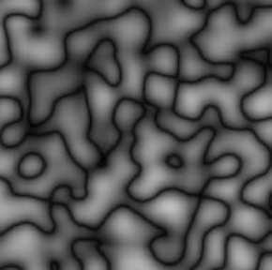
Texture Mapping
A way of adding surface detail
Two way can achieve the goal
Surface detail polygon : create extra polygon to model object details
Add scene complexity and slow down the graphics rendering speed
Map a texture to the surface (popular method)
Complexity of images does not affect the complexity of geometry

Slide 3
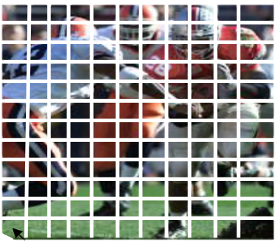
Texture Representation
Bitmap texture: pixels
A 2D image: a 2D array
Each pixel (or texel) by a unique pair texture coordinate (s, t)
The s and t are usually normalized to a [0, 1] range
For any given (s, t) in the normalize range, there is a unique image value (i.e., a unique [R, G, B])
(1,1)
t
(0,0)
s

Slide 4
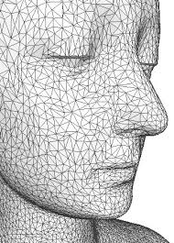
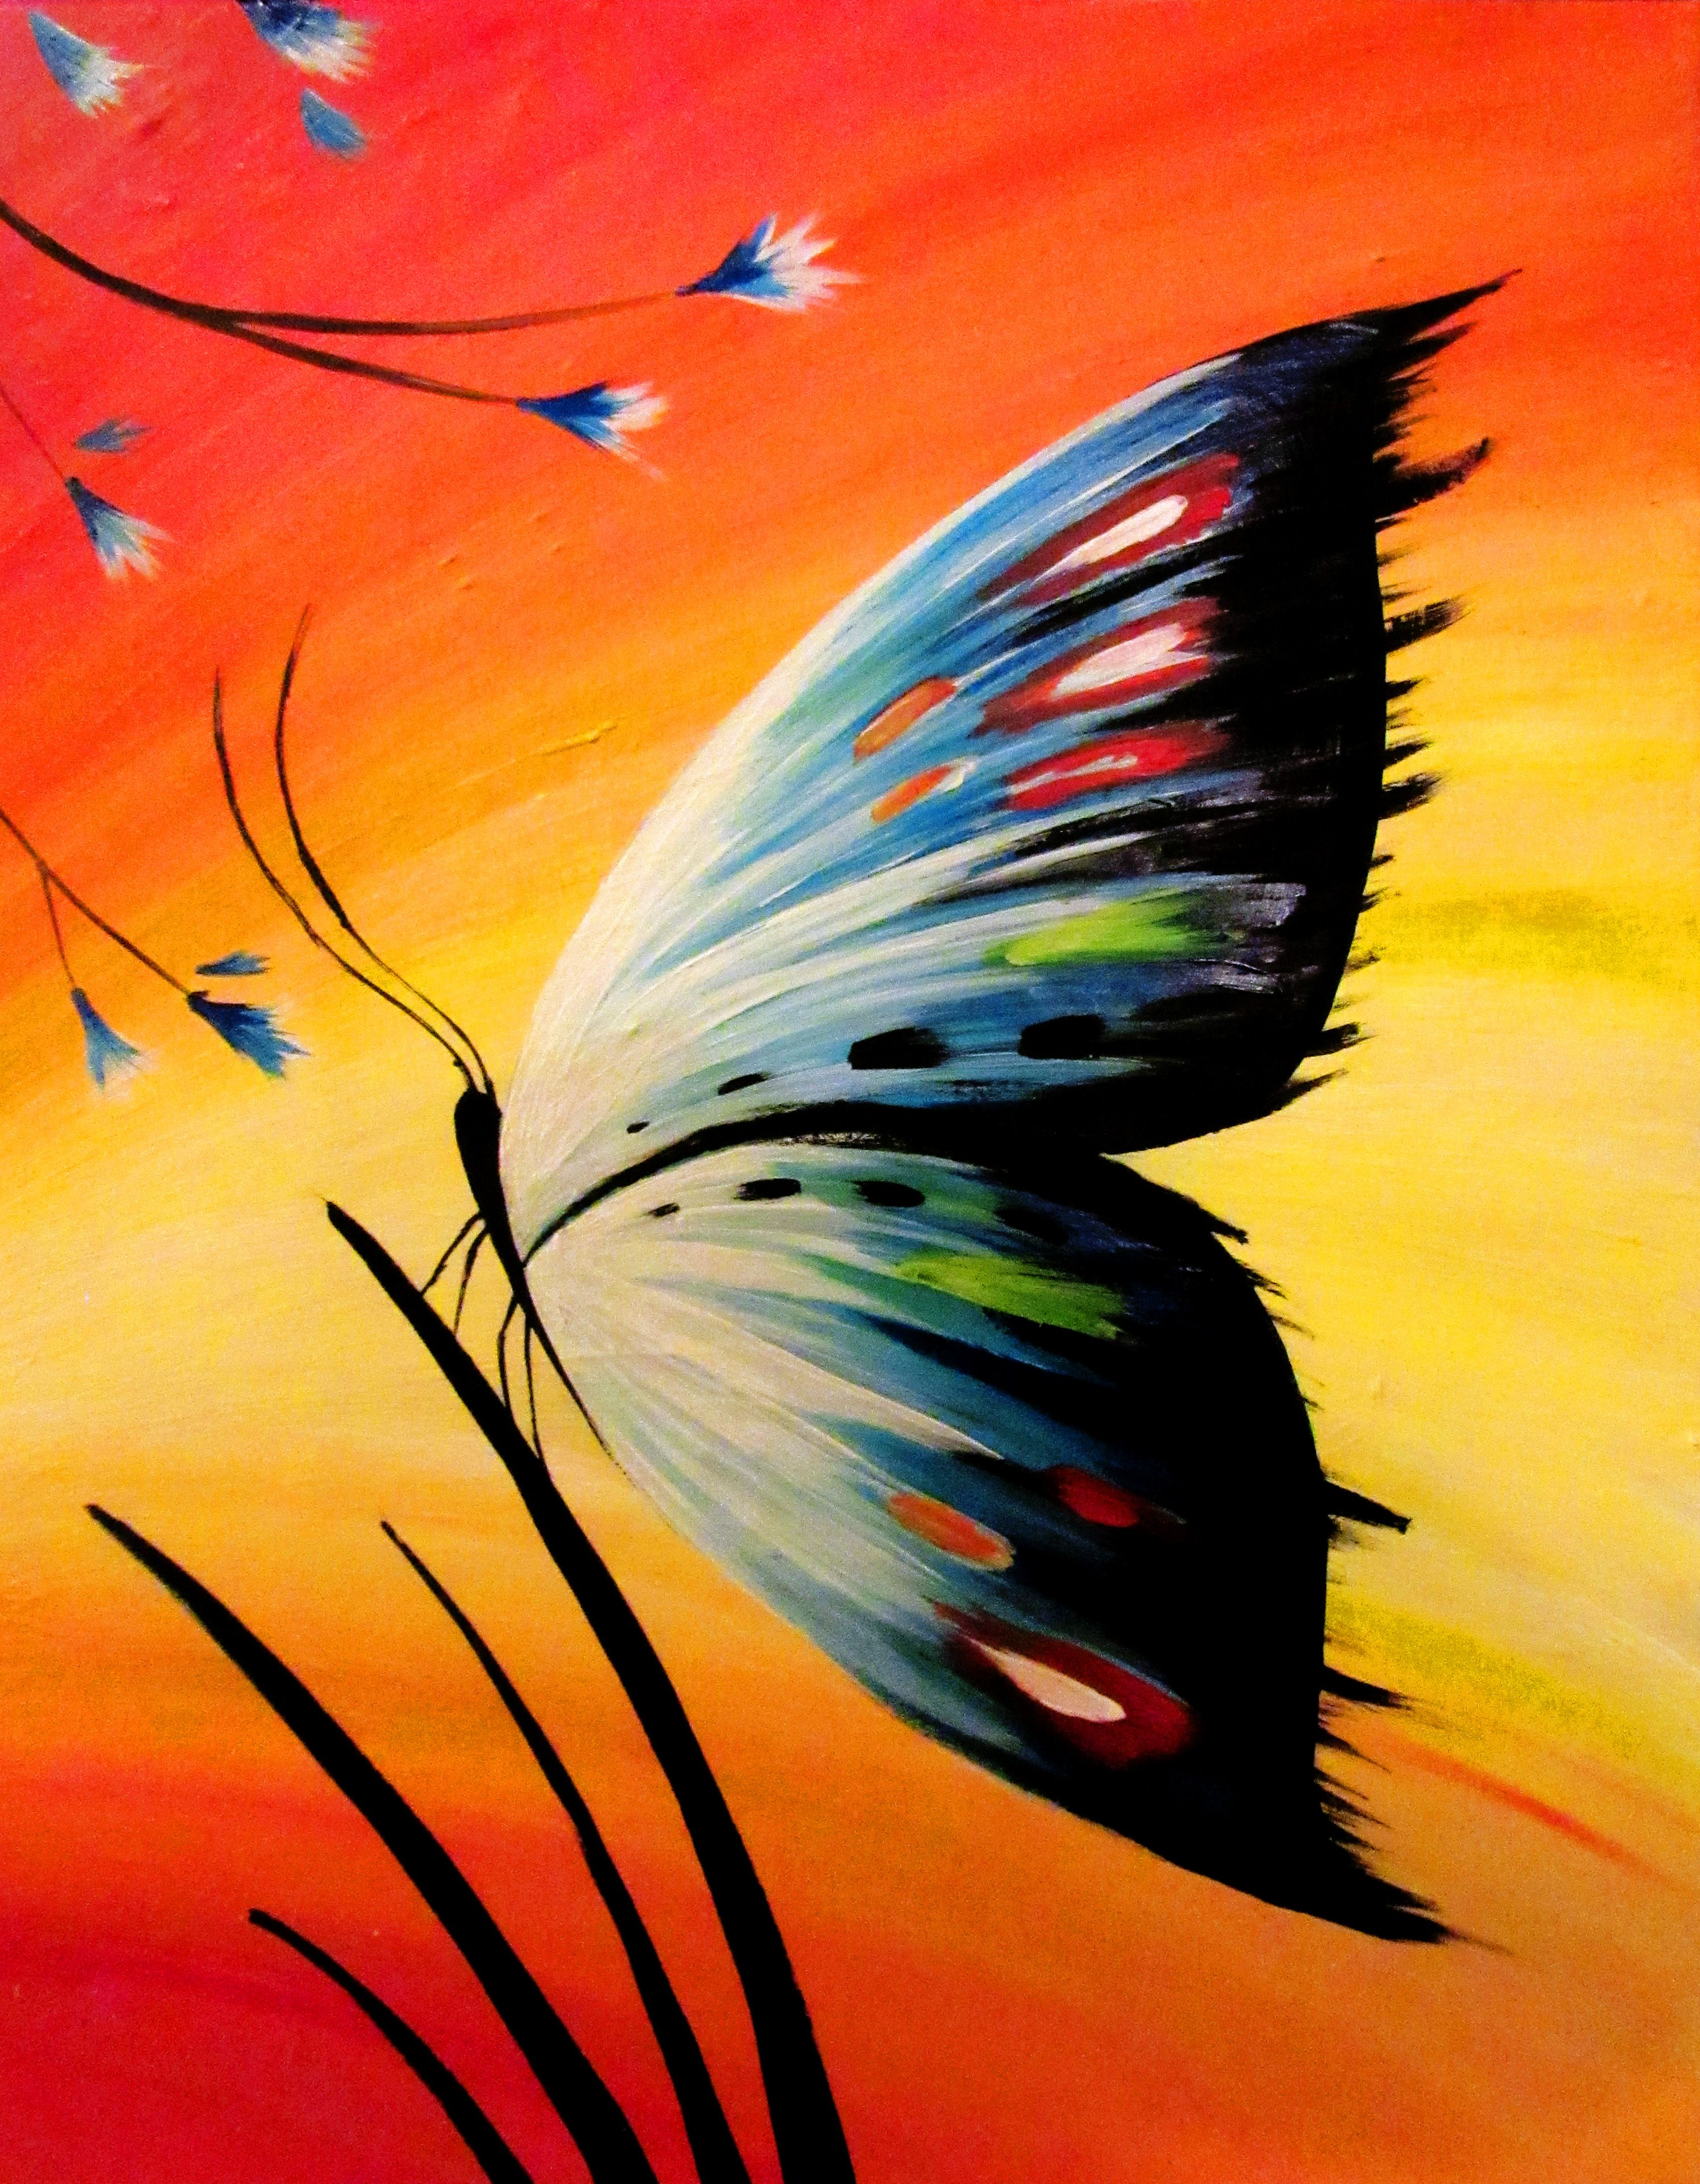
Map Textures to Surfaces
Vertex: using texture coordinate to establish mapping from texture to surfaces (polygons)
texCoord(0,1)
t
texCoord(1,1)
texCoord(1,0)
texCoord(0.5,0.5)
s
(0,0)

Slide 5
Map Textures to Surfaces
Inside a triangle: mapping is performed in rasterization
The texture coordinate is calculated by interpolating the texture coordinates on vertices of the triangle
Why not interpolate the color?
t
s
(0,0)

Slide 6
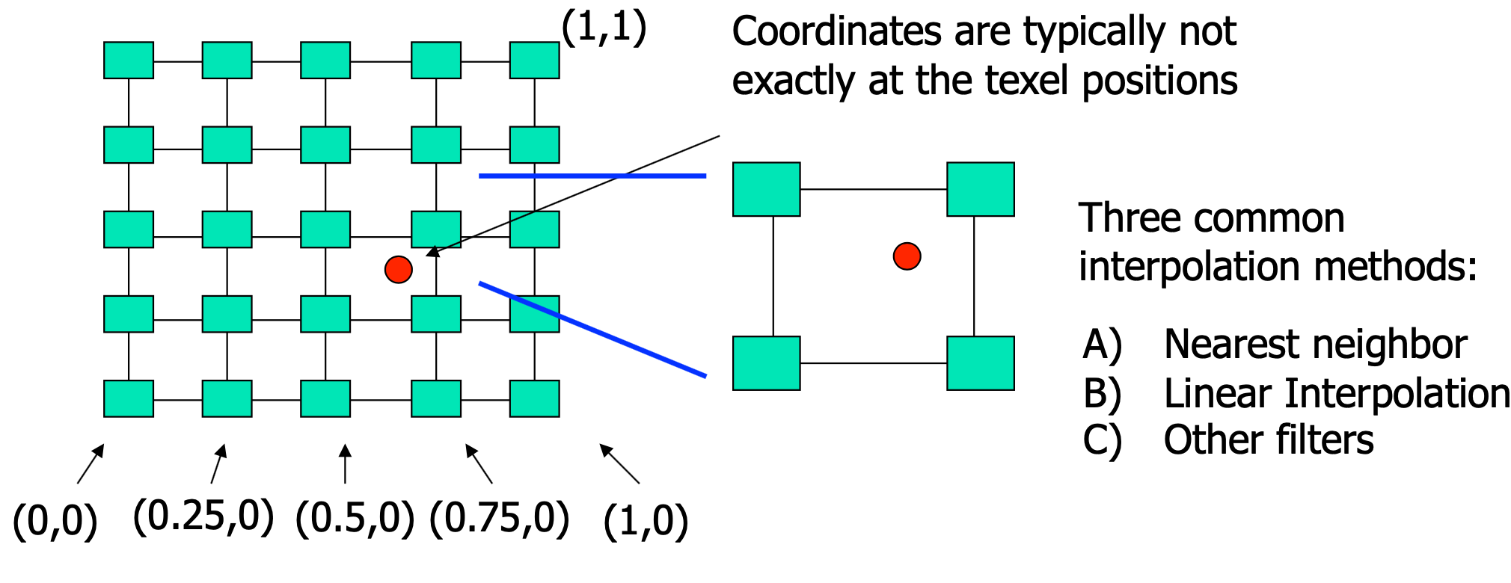
Map Textures to Surfaces
If we would like to have the texture coordinates within a polygon, like other vertex attributes, the texture coordinate is interpolated from vertices of the polygon
For the given texture coordinate (s, t), we can find a unique image value from the texture map

Slide 7
WebGL: Steps to Use Texture
Load the texture image
Prepare texture buffer
Create texture buffer: gl.createTexture()
Bind texture to a target: gl.bindTexture()
Indicate how to interpret the image: gl.pixelStorei()
Texture parameters: gl.texParameteri()
Assign the texture image to the texture target: gl.texImage2D()
Assign the texture to the shader
Active a texture unit: gl.activeTexture()
Bind texture to a target if necessary(): gl.bindTexture()
Pass the texture unit to a ‘sampler2D’ in shader: gl.uniform1i()
Call shader to draw
Get a color from the texture in shader: texture2D()

Slide 8
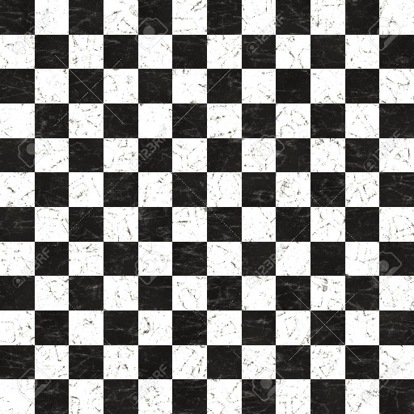
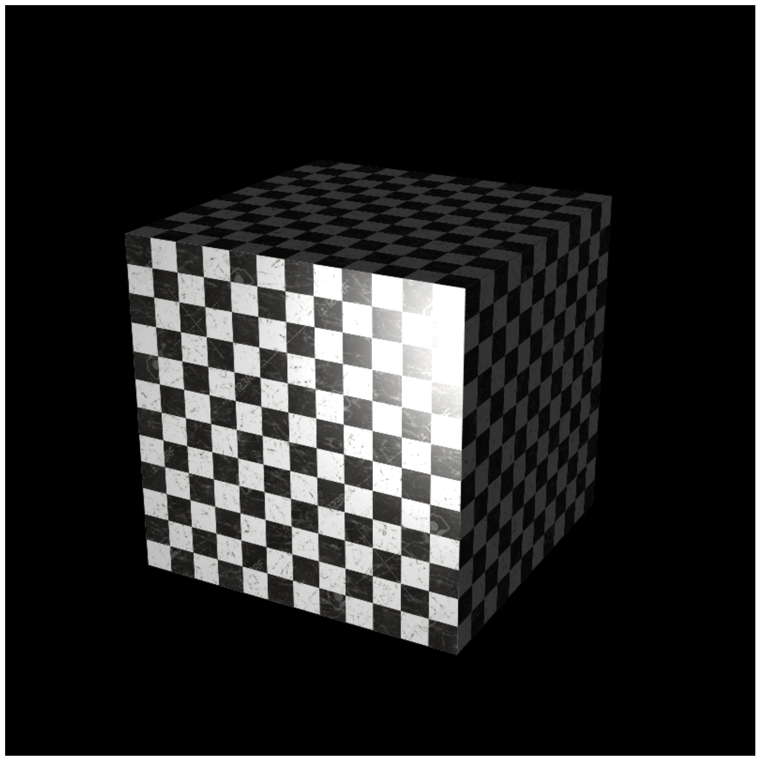
Example (Ex08-1)
Use chessboard texture to color the cube
Files
Index.html
WebGL.js
cuon-matrix.js
cube.obj
chess.jpg

Slide 9
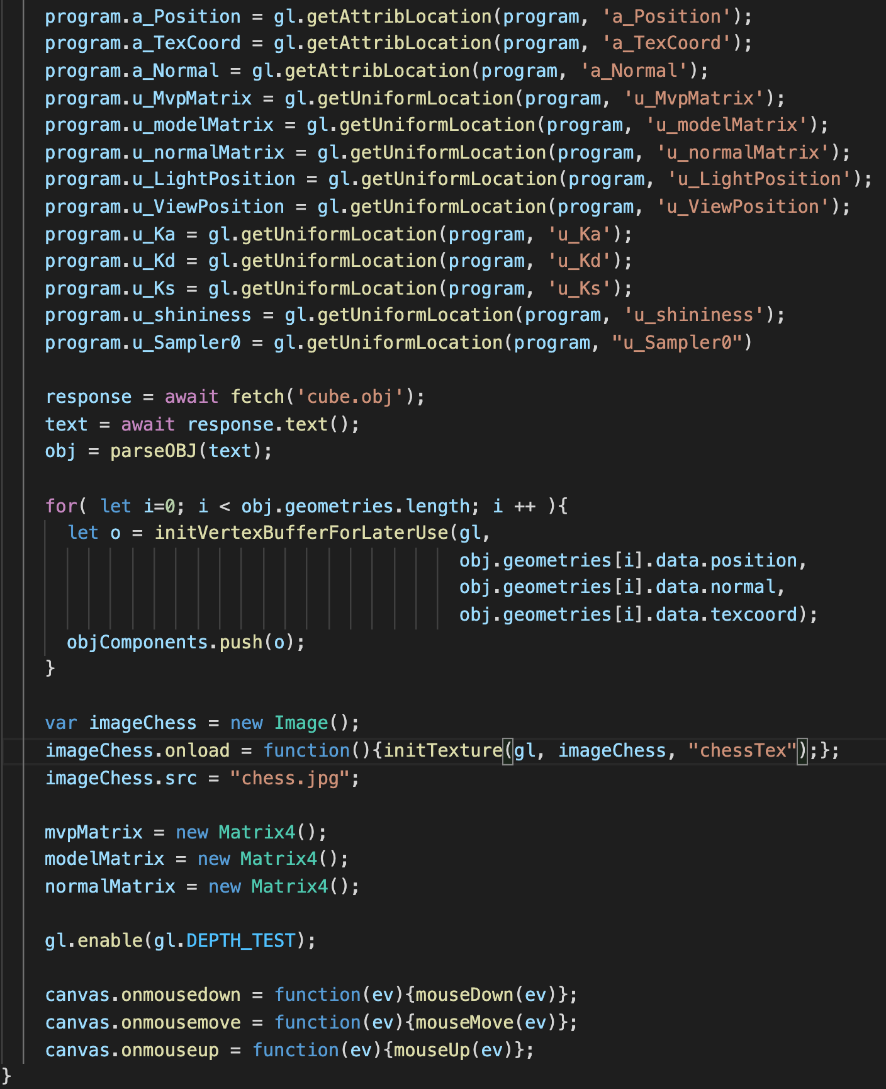
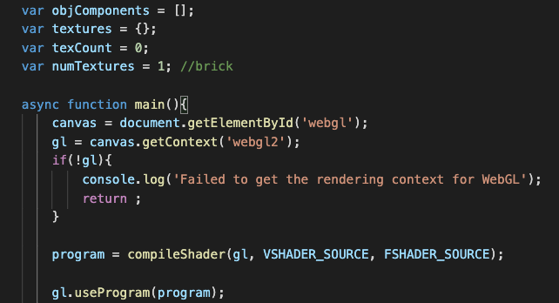
Example (Ex08-1)
main() in WebGL.js
Load the texture image
Prepare texture buffer
Create texture buffer: gl.createTexture()
Bind texture to a target: gl.bindTexture()
Indicate how to interpret the image: gl.pixelStorei()
Texture parameters: gl.texParameteri()
Assign the texture image to the texture target: gl.texImage2D()
Assign the texture to the shader
Active a texture unit: gl.activeTexture()
Bind texture to a target if necessary(): gl.bindTexture()
Pass the texture unit to a ‘sampler2D’ in shader: gl.uniform1i()
Call shader to draw
Get a color from the texture in shader: texture2D()
Load “chess.jpg” image
When the loading is done,
call initTexture() to create a texture

Slide 10
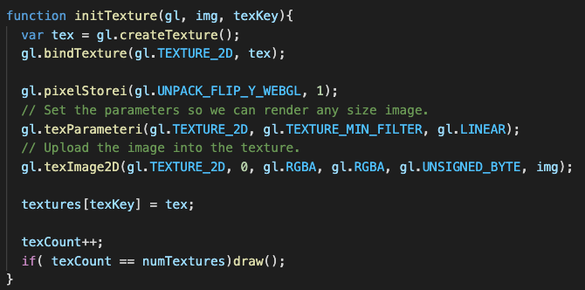
Example (Ex08-1)
….
gl.TEXTURE0
gl.TEXTURE1
gl.TEXTURE7
gl.TEXTURE_2D
gl.TEXTURE_CUBE
Texture buffer
(tex)
gl.createTexture()
Create a texture object
https://developer.mozilla.org/en-US/docs/Web/API/WebGLRenderingContext/createTexture
(You will have at least 8 texture units)
Load the texture image
Prepare texture buffer
Create texture buffer: gl.createTexture()
Bind texture to a target: gl.bindTexture()
Indicate how to interpret the image: gl.pixelStorei()
Texture parameters: gl.texParameteri()
Assign the texture image to the texture target: gl.texImage2D()
Assign the texture to the shader
Active a texture unit: gl.activeTexture()
Bind texture to a target if necessary(): gl.bindTexture()
Pass the texture unit to a ‘sampler2D’ in shader: gl.uniform1i()
Call shader to draw
Get a color from the texture in shader: texture2D()

Slide 11
Example (Ex08-1)
….
gl.TEXTURE0
gl.TEXTURE1
gl.TEXTURE7
gl.TEXTURE_2D
gl.TEXTURE_CUBE
Texture buffer
(tex)
gl.bindTexture(target, texture)
target: gl.TEXTURE_2D or gl.TEXTURE_CUBE
texture: texture object
https://developer.mozilla.org/en-US/docs/Web/API/WebGLRenderingContext/bindTexture
Load the texture image
Prepare texture buffer
Create texture buffer: gl.createTexture()
Bind texture to a target: gl.bindTexture()
Indicate how to interpret the image: gl.pixelStorei()
Texture parameters: gl.texParameteri()
Assign the texture image to the texture target: gl.texImage2D()
Assign the texture to the shader
Active a texture unit: gl.activeTexture()
Bind texture to a target if necessary(): gl.bindTexture()
Pass the texture unit to a ‘sampler2D’ in shader: gl.uniform1i()
Call shader to draw
Get a color from the texture in shader: texture2D()

Slide 12
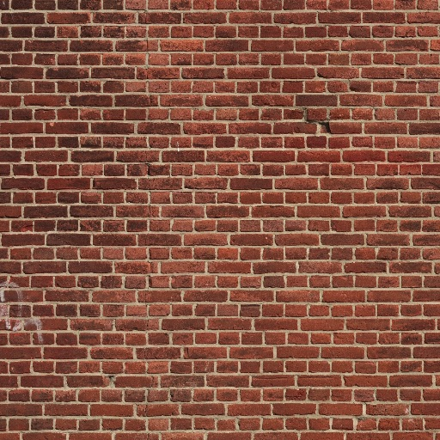
Example (Ex08-1)
x
….
gl.TEXTURE0
gl.TEXTURE1
gl.TEXTURE7
gl.TEXTURE_2D
image
gl.TEXTURE_CUBE
Texture buffer
(tex)
y
t
texture
gl.pixelStorei(pname, param)
https://developer.mozilla.org/en-US/docs/Web/API/WebGLRenderingContext/pixelStorei
if pname: gl.UNPACK_FLIP_Y_WEBGL and param = 1, the image is flipped along the y-axis
s
Load the texture image
Prepare texture buffer
Create texture buffer: gl.createTexture()
Bind texture to a target: gl.bindTexture()
Indicate how to interpret the image: gl.pixelStorei()
Texture parameters: gl.texParameteri()
Assign the texture image to the texture target: gl.texImage2D()
Assign the texture to the shader
Active a texture unit: gl.activeTexture()
Bind texture to a target if necessary(): gl.bindTexture()
Pass the texture unit to a ‘sampler2D’ in shader: gl.uniform1i()
Call shader to draw
Get a color from the texture in shader: texture2D()

Slide 13
Example (Ex08-1)
….
gl.TEXTURE0
gl.TEXTURE1
gl.TEXTURE7
gl.TEXTURE_2D
gl.TEXTURE_CUBE
Texture buffer
(tex)
gl.texParameteri(target, pname, param)
https://developer.mozilla.org/en-US/docs/Web/API/WebGLRenderingContext/texParameter
(1) Nearest neighbor (low quality, fast)
(2) Linear interpolation (high quality, slow)
gl.textParameter(…, gl.TEXTURE_MIN_FILTER, gl..LINEAR)
gl.textParameter(…, gl.TEXTURE_MIN_FILTER, gl.NEAREST)
Load the texture image
Prepare texture buffer
Create texture buffer: gl.createTexture()
Bind texture to a target: gl.bindTexture()
Indicate how to interpret the image: gl.pixelStorei()
Texture parameters: gl.texParameteri()
Assign the texture image to the texture target: gl.texImage2D()
Assign the texture to the shader
Active a texture unit: gl.activeTexture()
Bind texture to a target if necessary(): gl.bindTexture()
Pass the texture unit to a ‘sampler2D’ in shader: gl.uniform1i()
Call shader to draw
Get a color from the texture in shader: texture2D()

Slide 14
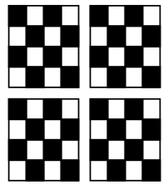
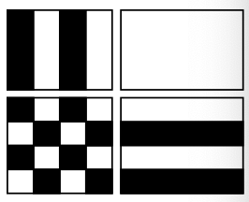
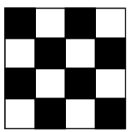
Example (Ex08-1)
What if the given texture coordinates (s, t) are outside [0,1] range?
Ex:
gl.texParameteri(…, gl.TEXTURE_WRAP_S, gl.CLAMP)
gl.texParameteri(…, gl.TEXTURE_WRAP_T, gl.CLAMP)
(2,2)
(2,2)
(1,1)
(0,0)
(0,0)
(0,0)
Original texture
gl.REPEAT
(default)
gl.CLAMP

Slide 15
Example (Ex08-1)
….
gl.TEXTURE0
gl.TEXTURE1
gl.TEXTURE7
gl.TEXTURE_2D
gl.TEXTURE_CUBE
Texture buffer
(tex)
gl.texImage2D(target, level, internalformat, format, type, image)
https://developer.mozilla.org/en-US/docs/Web/API/WebGLRenderingContext/texImage2D
target: gl.TEXTURE_2D or gl.TEXTURE_CUBE_MAP
level: level of detail
internalformat: image’s format
format: texture format (the same as the internal format)
type: type of the texture (per channel)
image: input texture image
Load the texture image
Prepare texture buffer
Create texture buffer: gl.createTexture()
Bind texture to a target: gl.bindTexture()
Indicate how to interpret the image: gl.pixelStorei()
Texture parameters: gl.texParameteri()
Assign the texture image to the texture target: gl.texImage2D()
Assign the texture to the shader
Active a texture unit: gl.activeTexture()
Bind texture to a target if necessary(): gl.bindTexture()
Pass the texture unit to a ‘sampler2D’ in shader: gl.uniform1i()
Call shader to draw
Get a color from the texture in shader: texture2D()

Slide 16
Example (Ex08-1)
….
gl.TEXTURE0
gl.TEXTURE1
gl.TEXTURE7
gl.TEXTURE_2D
gl.TEXTURE_CUBE
Texture buffer
(tex)
Render the first frame
if the loading of all textures is done
Save the texture we create
Load the texture image
Prepare texture buffer
Create texture buffer: gl.createTexture()
Bind texture to a target: gl.bindTexture()
Indicate how to interpret the image: gl.pixelStorei()
Texture parameters: gl.texParameteri()
Assign the texture image to the texture target: gl.texImage2D()
Assign the texture to the shader
Active a texture unit: gl.activeTexture()
Bind texture to a target if necessary(): gl.bindTexture()
Pass the texture unit to a ‘sampler2D’ in shader: gl.uniform1i()
Call shader to draw
Get a color from the texture in shader: texture2D()

Slide 17
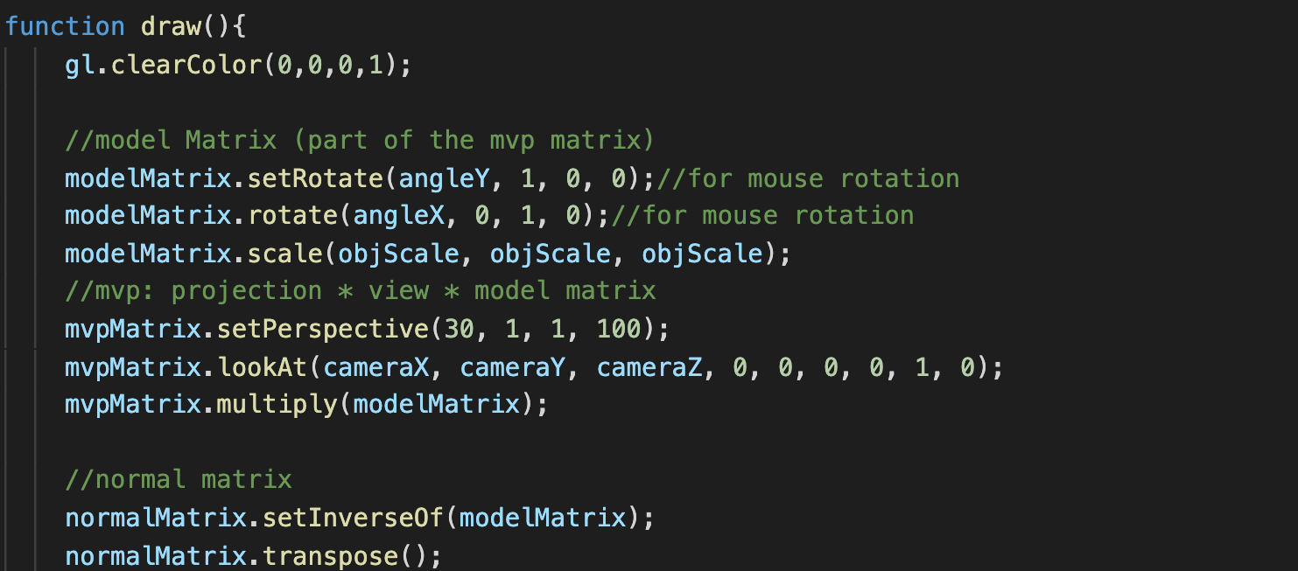
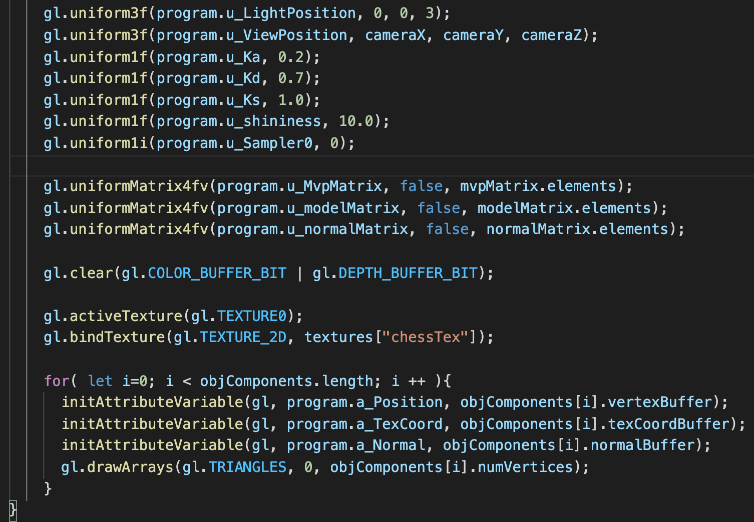
Example (Ex08-1)
….
gl.TEXTURE0
gl.TEXTURE1
gl.TEXTURE7
gl.TEXTURE_2D
gl.TEXTURE_CUBE
Texture buffer
(tex)
draw() in WebGL.js
Of course, beside pass vertex position and normal vector information, we also have to pass texture coordinates of the object vertices to shader (to an attribute variable)
Load the texture image
Prepare texture buffer
Create texture buffer: gl.createTexture()
Bind texture to a target: gl.bindTexture()
Indicate how to interpret the image: gl.pixelStorei()
Texture parameters: gl.texParameteri()
Assign the texture image to the texture target: gl.texImage2D()
Assign the texture to the shader
Active a texture unit: gl.activeTexture()
Bind texture to a target if necessary(): gl.bindTexture()
Pass the texture unit to a ‘sampler2D’ in shader: gl.uniform1i()
Call shader to draw
Get a color from the texture in shader: texture2D()

Slide 18
Example (Ex08-1)
….
gl.TEXTURE0
gl.TEXTURE1
gl.TEXTURE7
gl.TEXTURE_2D
gl.TEXTURE_CUBE
Texture buffer
(tex)
draw() in WebGL.js
Load the texture image
Prepare texture buffer
Create texture buffer: gl.createTexture()
Bind texture to a target: gl.bindTexture()
Indicate how to interpret the image: gl.pixelStorei()
Texture parameters: gl.texParameteri()
Assign the texture image to the texture target: gl.texImage2D()
Assign the texture to the shader
Active a texture unit: gl.activeTexture()
Bind texture to a target if necessary(): gl.bindTexture()
Pass the texture unit to a ‘sampler2D’ in shader: gl.uniform1i()
Call shader to draw
Get a color from the texture in shader: texture2D()

Slide 19
Example (Ex08-1)
….
gl.TEXTURE0
gl.TEXTURE1
gl.TEXTURE7
gl.TEXTURE_2D
gl.TEXTURE_CUBE
Texture buffer
(tex)
draw() in WebGL.js
u_Sampler0 (shader)
0? Because we bind the texture to TEXTURE0
Load the texture image
Prepare texture buffer
Create texture buffer: gl.createTexture()
Bind texture to a target: gl.bindTexture()
Indicate how to interpret the image: gl.pixelStorei()
Texture parameters: gl.texParameteri()
Assign the texture image to the texture target: gl.texImage2D()
Assign the texture to the shader
Active a texture unit: gl.activeTexture()
Bind texture to a target if necessary(): gl.bindTexture()
Pass the texture unit to a ‘sampler2D’ in shader: gl.uniform1i()
Call shader to draw
Get a color from the texture in shader: texture2D()

Slide 20
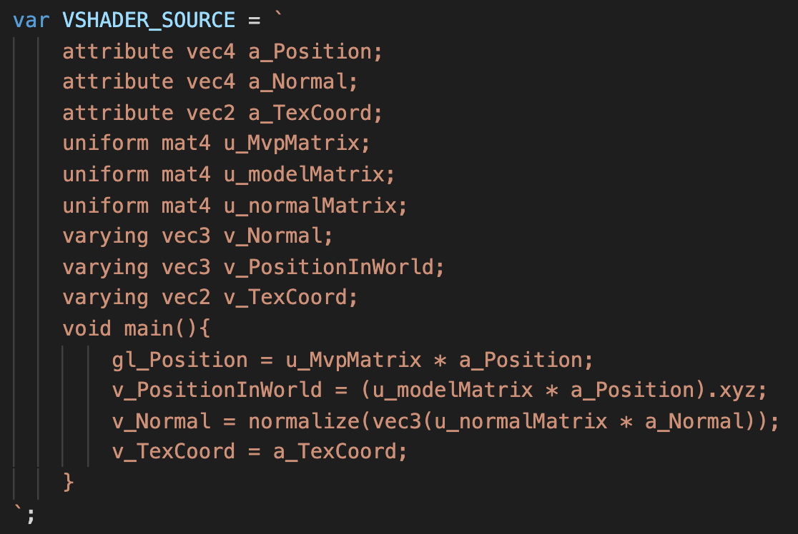
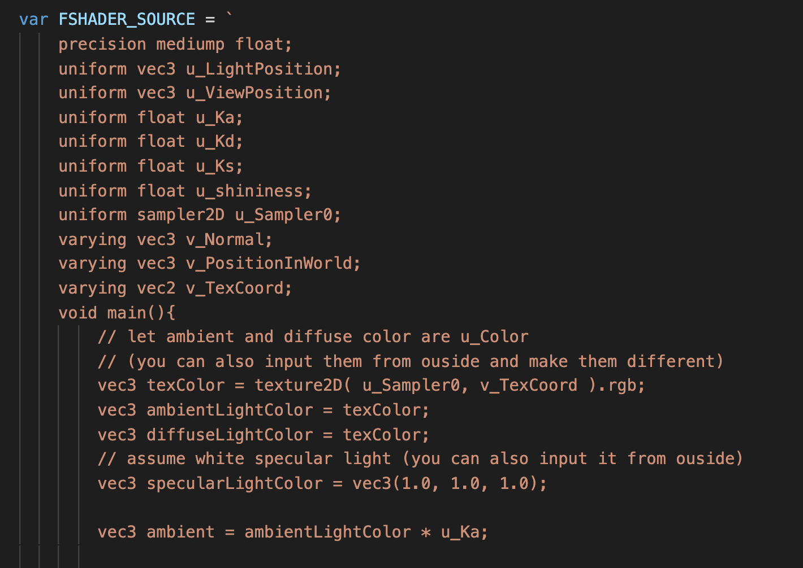
Example (Ex08-1)
….
gl.TEXTURE0
gl.TEXTURE1
gl.TEXTURE7
gl.TEXTURE_2D
gl.TEXTURE_CUBE
Texture buffer
(tex)
Shader in WebGL.js
u_Sampler0 (shader)
Texture coordinate of a fragment is calculated from the texture coordinates
of vertices of the triangle by interpolation
Load the texture image
Prepare texture buffer
Create texture buffer: gl.createTexture()
Bind texture to a target: gl.bindTexture()
Indicate how to interpret the image: gl.pixelStorei()
Texture parameters: gl.texParameteri()
Assign the texture image to the texture target: gl.texImage2D()
Assign the texture to the shader
Active a texture unit: gl.activeTexture()
Bind texture to a target if necessary(): gl.bindTexture()
Pass the texture unit to a ‘sampler2D’ in shader: gl.uniform1i()
Call shader to draw
Get a color from the texture in shader: texture2D()

Slide 21
Example (Ex08-1)
….
gl.TEXTURE0
gl.TEXTURE1
gl.TEXTURE7
gl.TEXTURE_2D
gl.TEXTURE_CUBE
Texture buffer
(tex)
Shader in WebGL.js
sampler2D is the variable type to hold a 2D texture
Use “texture2D()” to get a texture color (RGBA) from a sampler2D variable
First parameter: the texture
Second parameter: a texture coordinate
Return: a RGBA color
u_Sampler0 (shader)
Load the texture image
Prepare texture buffer
Create texture buffer: gl.createTexture()
Bind texture to a target: gl.bindTexture()
Indicate how to interpret the image: gl.pixelStorei()
Texture parameters: gl.texParameteri()
Assign the texture image to the texture target: gl.texImage2D()
Assign the texture to the shader
Active a texture unit: gl.activeTexture()
Bind texture to a target if necessary(): gl.bindTexture()
Pass the texture unit to a ‘sampler2D’ in shader: gl.uniform1i()
Call shader to draw
Get a color from the texture in shader: texture2D()

Slide 22
Let’s try (5mins)
Make sure you know the step to use a texture and how to pass it to shader
Change gl.uniform1i(program.u_Sampler0, 0) to gl.uniform1i(program.u_Sampler0, 2), does it work?
What if you also modify gl.activeTexture(gl.TEXTURE0) to gl.activeTexture(gl.TEXTURE2), does it work?
Try any thing you want.

Slide 23

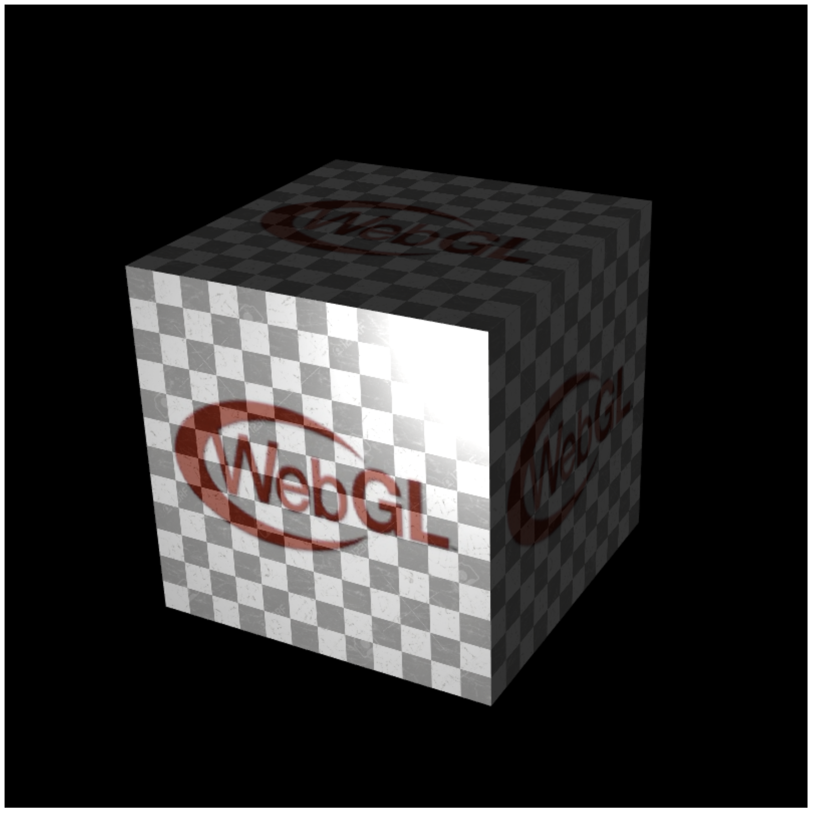
Example (Ex08-2)
Mix multiple textures to color the cube
Use multiple textures
Files
Index.html
WebGL.js
cuon-matrix.js
cube.obj
chess.jpg
webglIcon.jpg

Slide 24
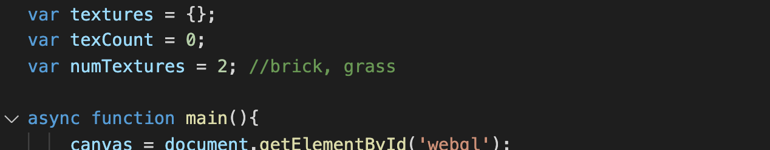
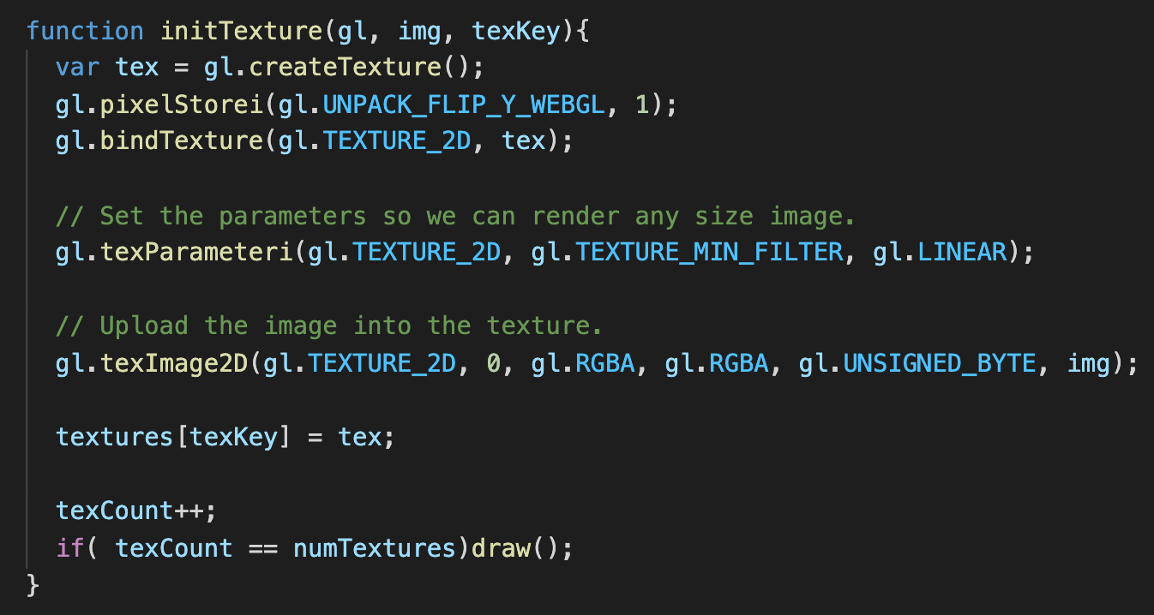
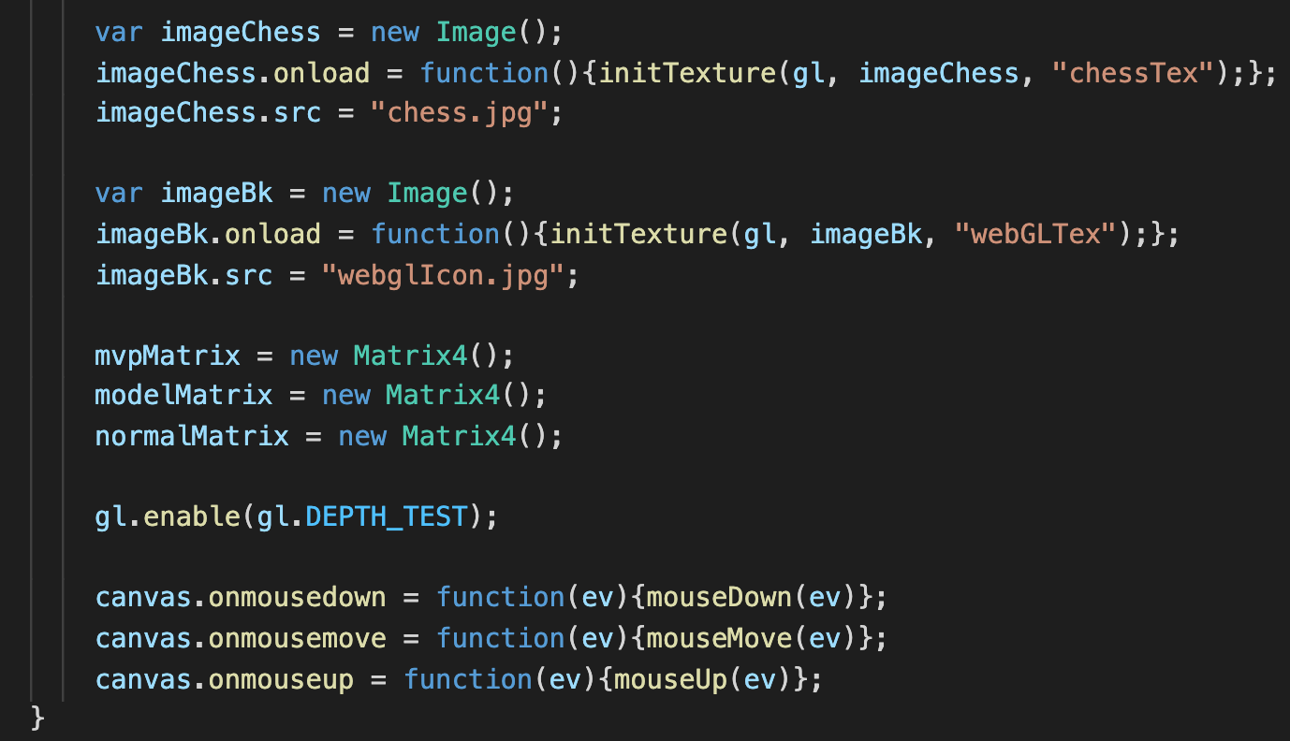
Example (Ex08-2)
….
gl.TEXTURE0
gl.TEXTURE1
gl.TEXTURE7
gl.TEXTURE_2D
gl.TEXTURE_CUBE
Texture buffer
(tex)
Texture buffer
(tex)
main(): load one more texture
Also call initTexture to initialize each texture
Store each texture in a dictionary, “textures”

Slide 25
Example (Ex08-2)
….
gl.TEXTURE0
gl.TEXTURE1
gl.TEXTURE7
gl.TEXTURE_2D
gl.TEXTURE_CUBE
Texture buffer
(tex)
Texture buffer
(tex)
draw the first frame if all texture loading is done

Slide 26
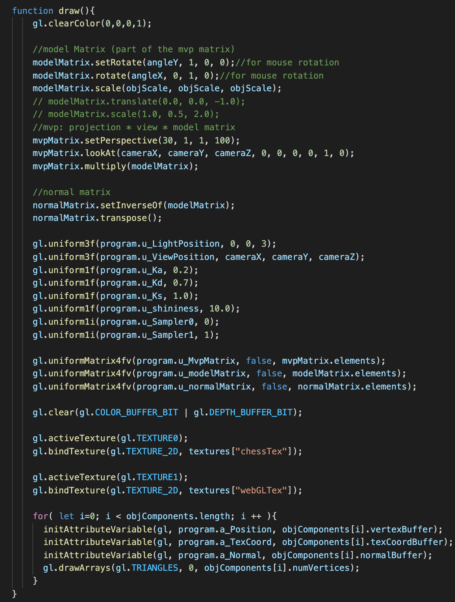
Example (Ex08-2)
….
gl.TEXTURE0
gl.TEXTURE1
gl.TEXTURE7
gl.TEXTURE_2D
gl.TEXTURE_CUBE
Texture buffer
(tex)
Texture buffer
(tex)
Bind textures to texture units
Assign texture units to sampler2D variables in shader

Slide 27
Example (Ex08-2)
….
gl.TEXTURE0
gl.TEXTURE1
gl.TEXTURE7
gl.TEXTURE_2D
gl.TEXTURE_CUBE
Texture buffer
(tex)
Texture buffer
(tex)
u_Sampler1 (shader)
Bind textures to texture units
Assign texture units to sampler2D variables in shader
u_Sampler0 (shader)

Slide 28
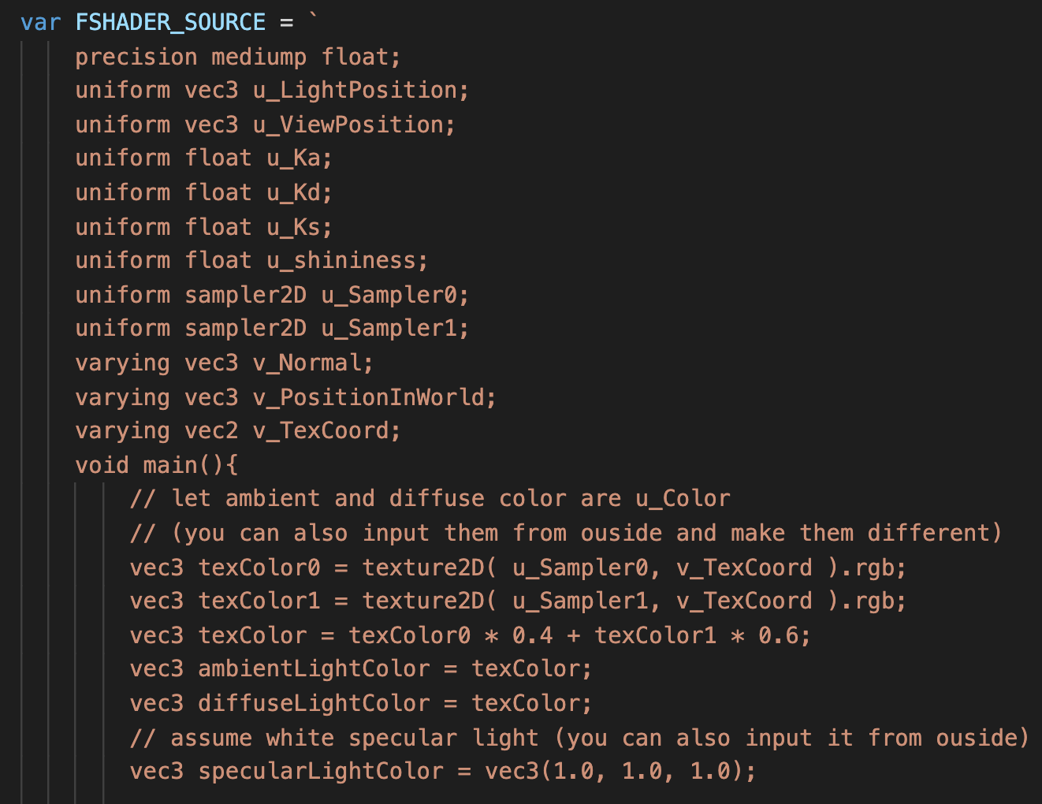
Example (Ex08-2)
Fragment shader
Mix color from two textures

Slide 29
Let’s try (5mins)
Try to modify this line, “vec3 texColor = texColor0 *0.4 + texColor1 *0.6”;, to vec3 texColor = texColor0 *0.7 + texColor1 *0.3
Change this line to other weight factors to mix them, make sure you understand it
If you want to pass the third textures to shader, try to think what you should do?
Try any thing you want

Slide 30
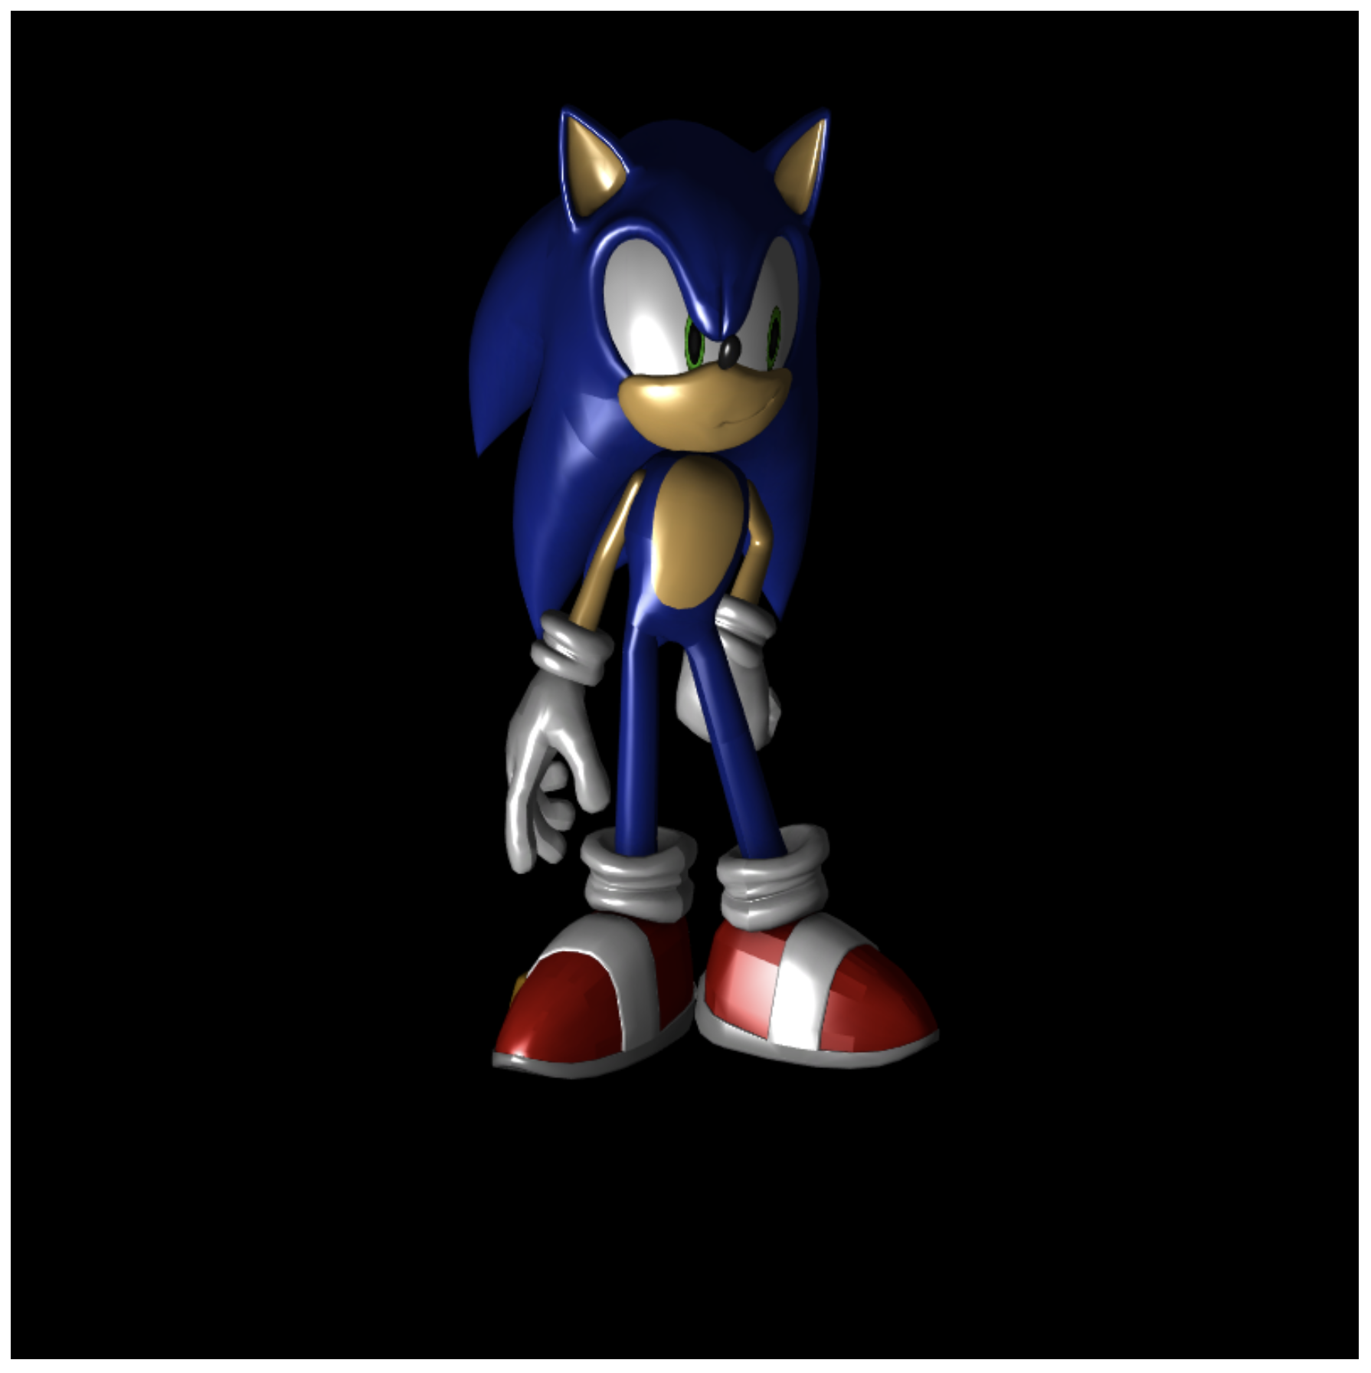
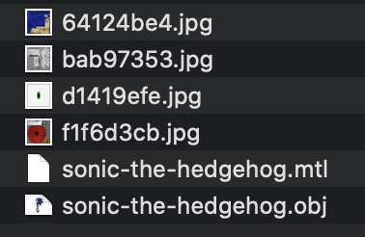
Color an Obj File Object by Texture Images
The obj file from clara.io usually includes texture images for the object
The metadata is in *.mtl file

Slide 31
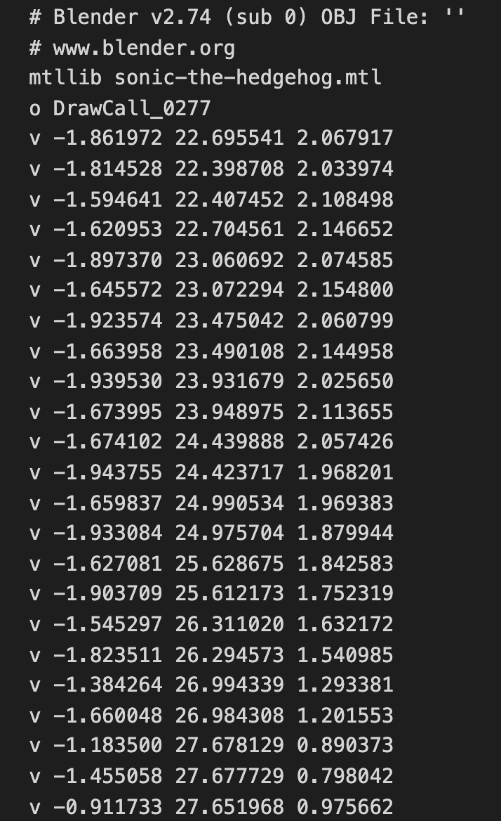
Color an Obj File Object by Texture Images
Review the obj files
use sonic as an example (it consist of 13 components)
Tell you where the material metadata file is

Slide 32
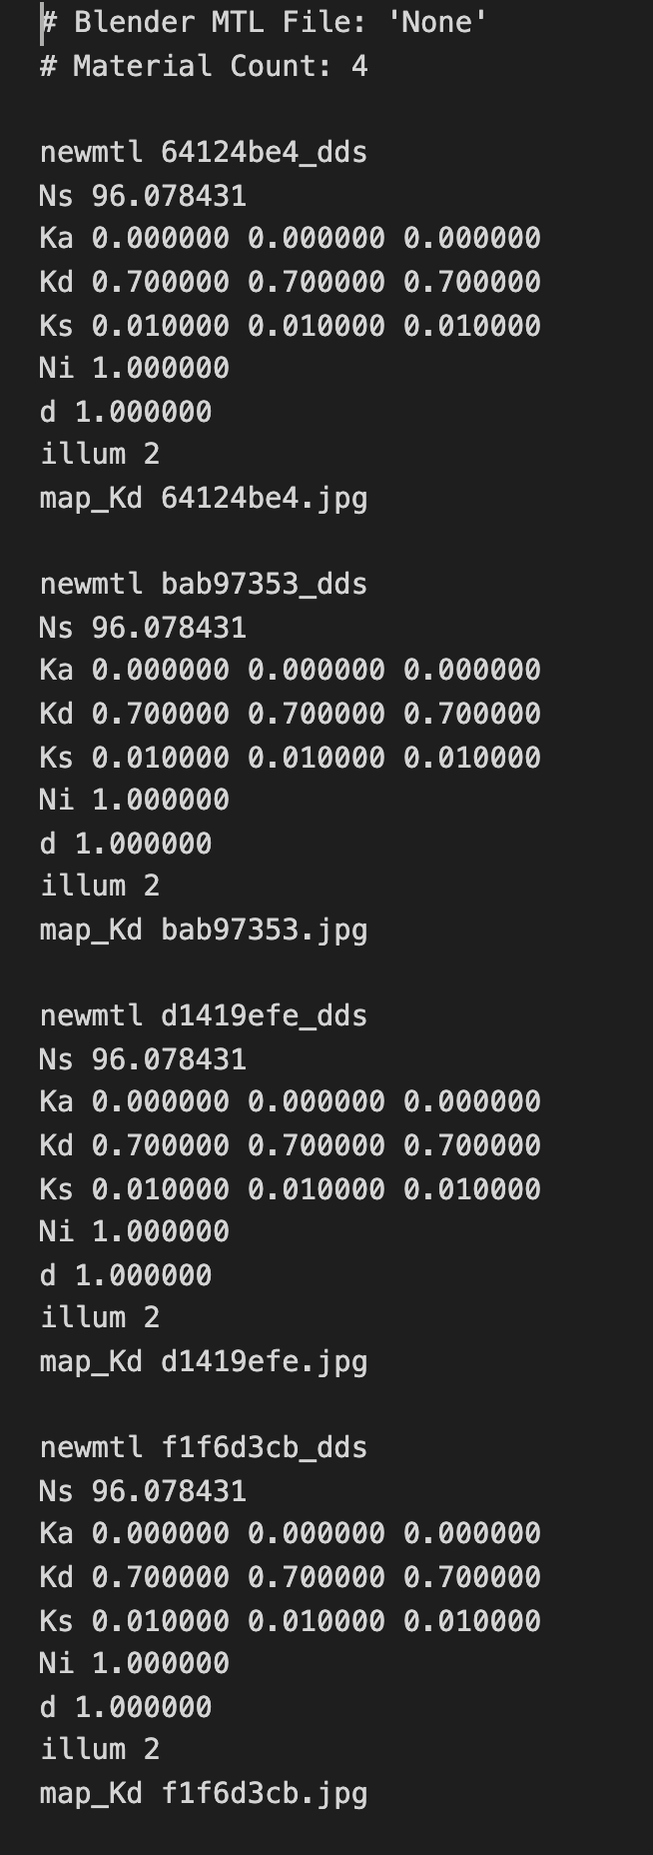
Color an Obj File Object by Texture Images
sonic-the-hedgehog.mtl
Although sonic consist of 13 components
It only has 4 different materials
Each material has its own illumination parameters (ka, kd, ks…) and texture image

Slide 33
Color an Obj File Object by Texture Images
Material IDs

Slide 34
Color an Obj File Object by Texture Images
Texture image of each material

Slide 35
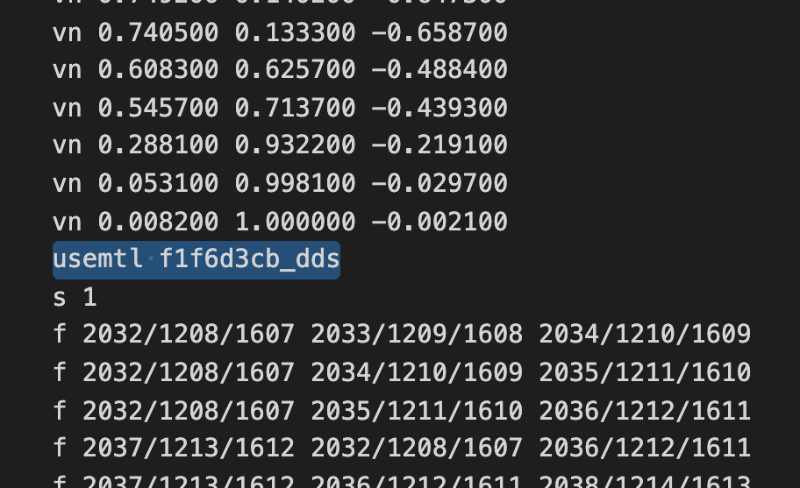
Color an Obj File Object by Texture Images
Back to the obj file again
If you search the keyword “usemtl”, you will realize that each component has one “usemtl” line (usually right before ”face” section).
It tells you what the material information is of this component
Ex: usemtl f1f6d3cb_dds (so the texture image for this component is “f1f6d3cb.jpg”)
So, you can find 13 usemtl lines in the sonic obj file

Slide 36
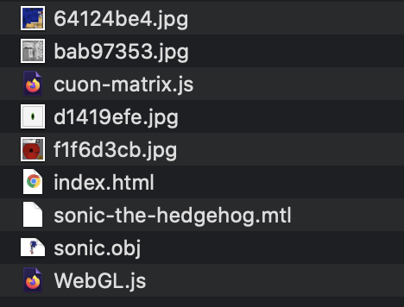
Example (Ex08-3)
Use texture images to color the sonic
Files

Slide 37
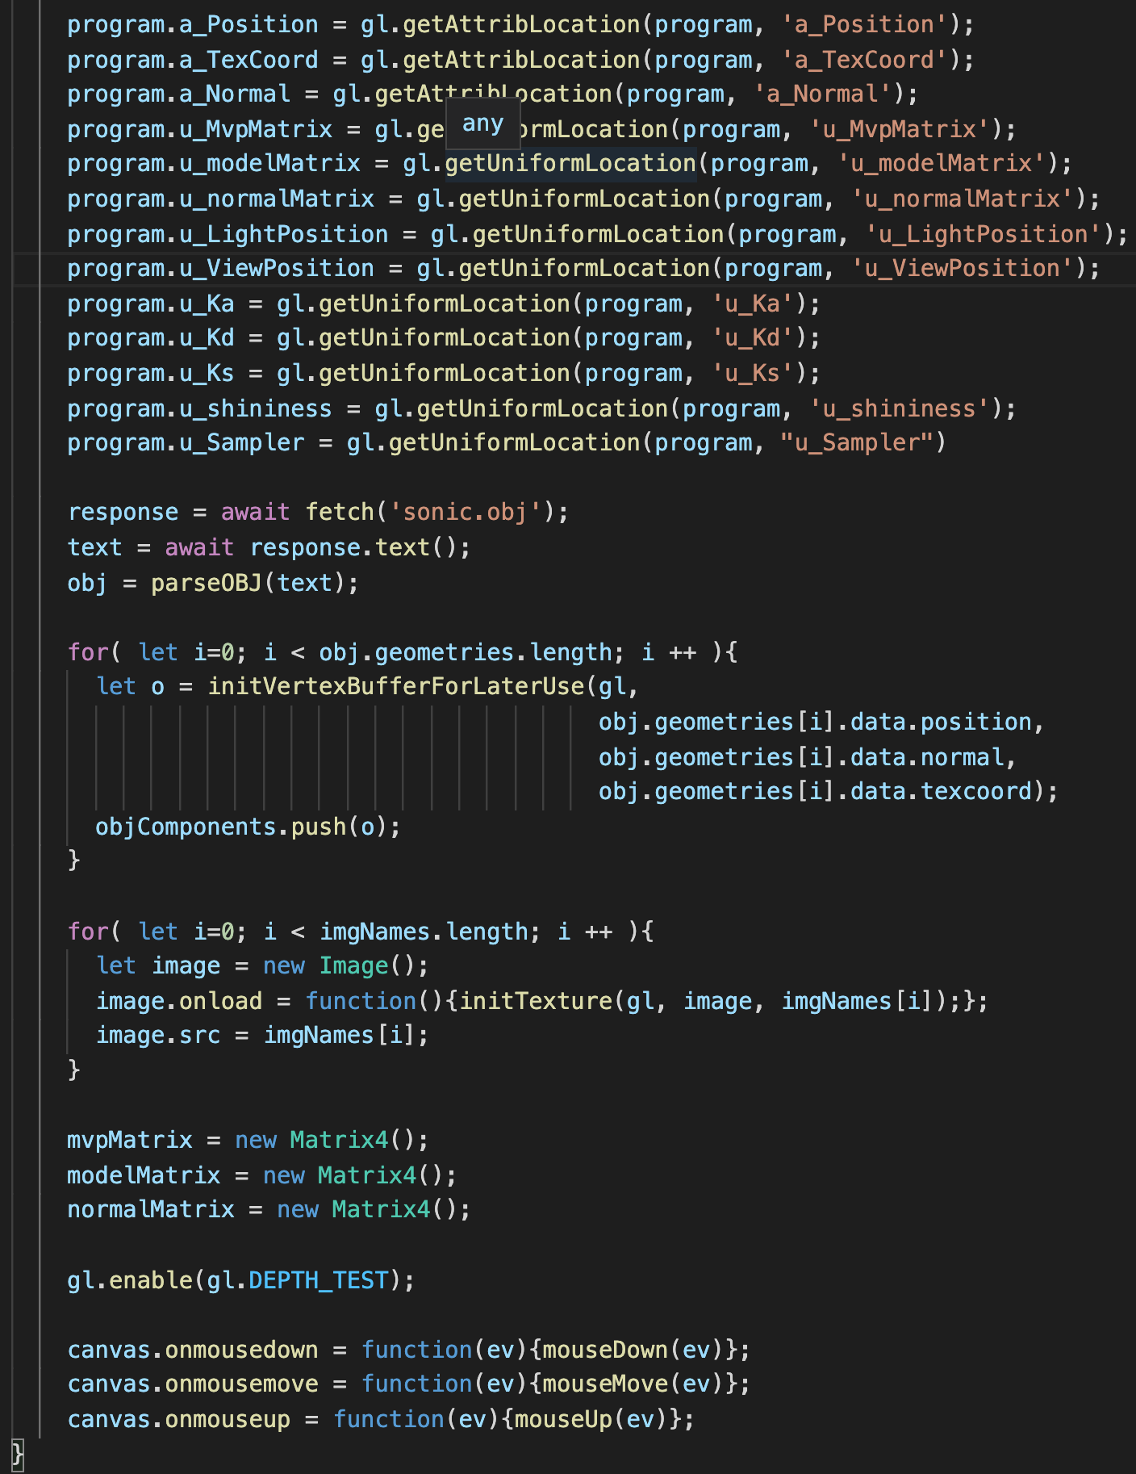
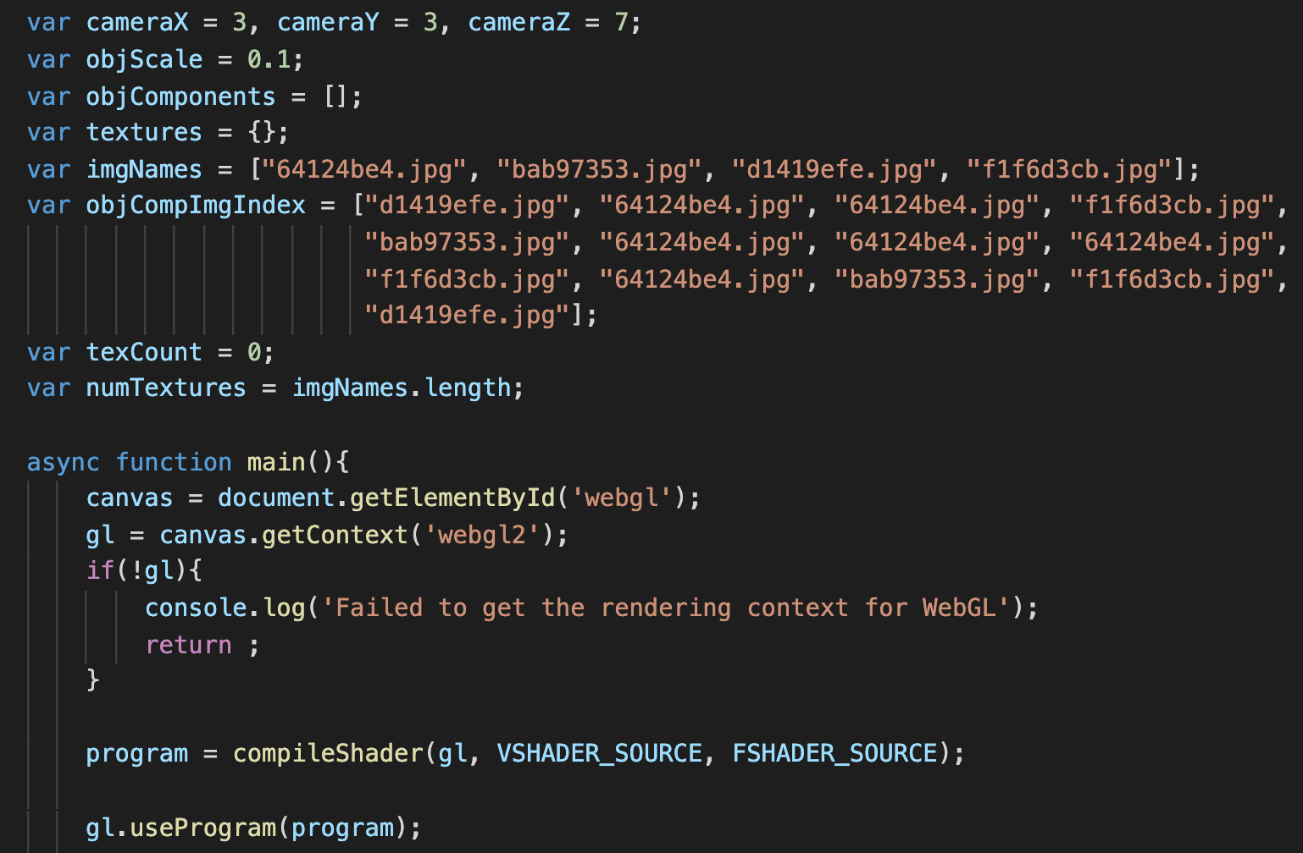
Example (Ex08-3)
main() in WebGL.js
I do not write a parser to parse the mtl file. So, I manually create and hardcode the mapping between object components and texture images
It is better if you write a parser for mtl file.
load and setup components and texture images

Slide 38
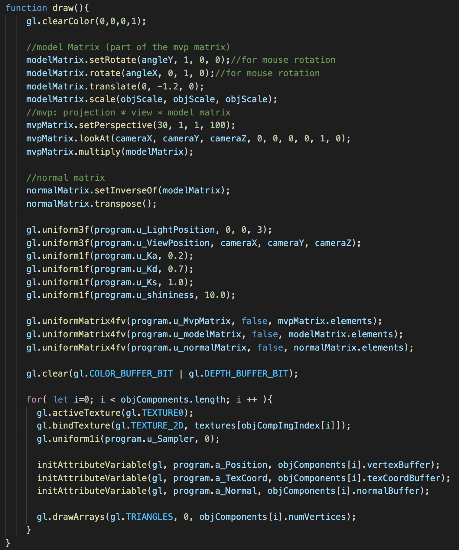
Example (Ex08-3)
draw() in WebGL.js
Before drawing a component bind the corresponding texture image to TEXTURE0, and tell u_Sampler to use the texture unit 0
Draw components one by one

Slide 39
Let’s try
Make sure you know .mtl file and you know an object component should map to which texture image

